Slide 1
Sound event detection with neural networks
Moritz Augustin
NI Group Meeting, 13th July 2018

Slide 2
Introduction
Two!Ears EU project
Sound event database: NIGENS anechoic earsignals
Binaural simulator software: scene mixtures varying noise & sources
System expertise: Ivo
Methods relied on
Linear feedforward models: logistic regression
Engineered features: temporal information via derivative statistics (500ms blocks)
Extension in progress: nonlinear & temporal models
Deep neural networks
Recurrent networks: long short-term memory
Feedforward (convolutional) neural networks
Directly applicable to features with fine temporal resolution
Representations learnt via supervised training
Hypothesis: improved generalization performance over baseline model
Neural Information Processing Group General Sounds Database Earsignals
Trowitzsch, Mohr, Kashef, Obermayer 2017,
IEEE Audio Speech Language Process.
Heiner Spieß, NI project
Changbin Lu, Master thesis
Alessandro Schneider, Bachelor thesis

Slide 3
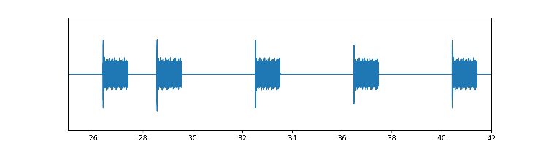
Data: Isolated Sounds
Sounds from combined training+devel set only:
Class | Waves (count) | min-max (sec) | Total time (min)
Alarm | 49 | 0.9 – 64.6 | 16
Baby | 40 | 1.7 - 123.4 | 18
Crash | 50 | 1.7 – 48.3 | 8
Dog | 45 | 0.2 – 49.4 | 9
Engine | 39 | 4.0 - 132.7 | 35
Scream | 76 | 0.5 – 94.5 | 6
FemaleSpeech | 100 | 1.2 – 5.1 | 5
Fire | 51 | 2.4 – 162.1 | 45
Footsteps | 42 | 3.0 – 33.0 | 19
Knock | 40 | 0.6 – 14.4 | 2
MaleSpeech | 100 | 1.5 – 5.0 | 4
Phone | 40 | 1.0 - 65.0 | 12
Piano | 42 | 2.3 – 196.0 | 15
Total | 714 | 0.2 – 196.0 | 194
General class | 303 | 0.2 – 180.6 | 92
NIGENS: human-labeled sounds (on/offsets) from 13 classes
Example: a phone sound (12sec)
wave
time (sec)
label
Trowitzsch, Taghia, Kashef, Obermayer 2016, Zenodo: https://zenodo.org/record/168042

Slide 4
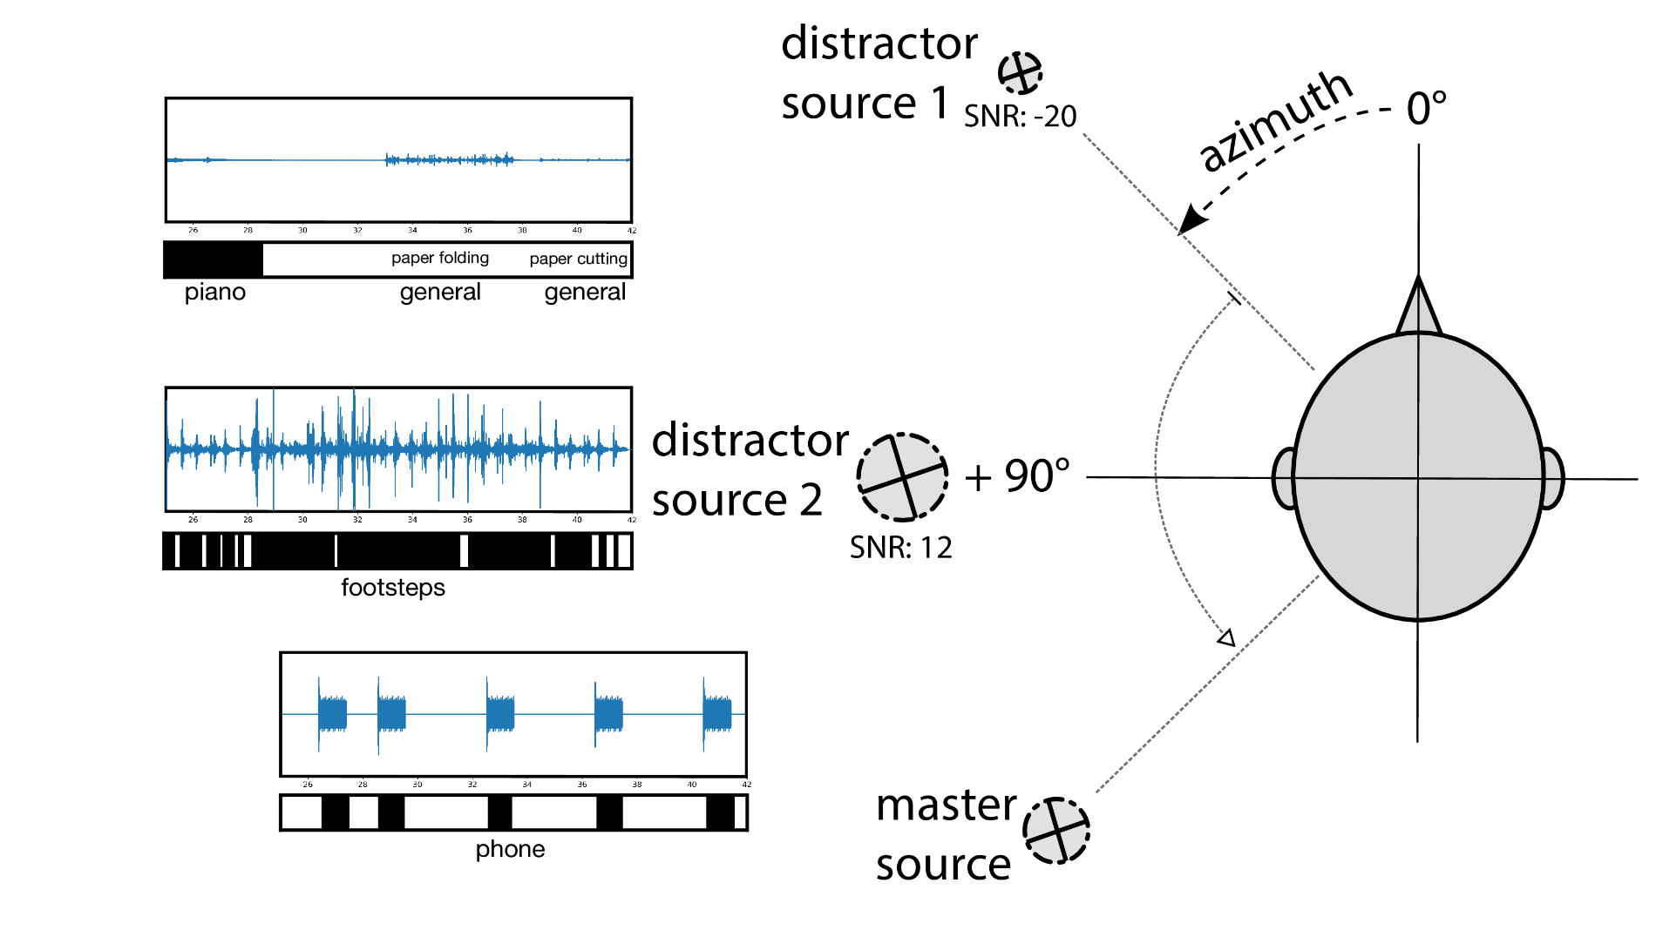
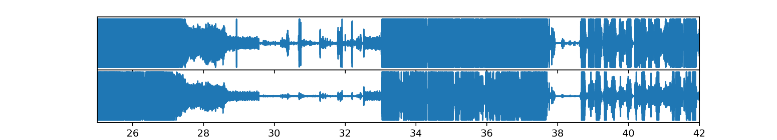
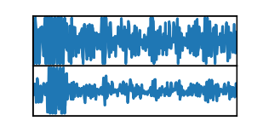
Data: Scenes
Mixtures: binaurally recorded simulated scene instance (min: 30sec)
Master: one sound (of non-general class), e.g. Phone (<30sec: repeated)
0-3 distractors: random sounds (incl. general & master class)
Scene: Fixed values of scene parameter (#src, azimuth, SNR)
Scene instance: Scene with a specific sound mixture
Correction (visualization wrong):
ds1 amp > master > ds2 amp
Resulting scene instance (stereo mixture)
left
right

Slide 5
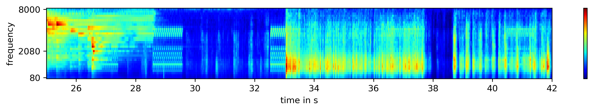
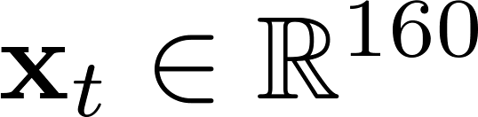
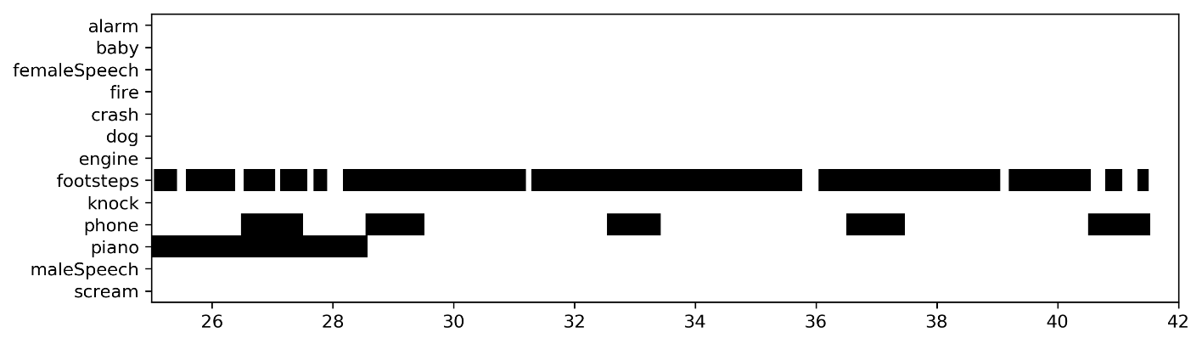
Data: Features
Mixture
(stereo)
20 ms (frame)
Left/right ratemap avgeraged
Left/right AMS averaged
=>
concatenated
& flattened:
Ratemap: 32 dim.
~biologically inspired Fourier transform
Amplitude modulation
spectra (AMS): 16x8 dim.
Frame overlap: ½ => time step: 10 ms
~Fourier transform of signal envelope
Labels: 13 dim. (binary, multilabel)

Slide 6
Data: Validation
Training & validation data
Test data
1/8 of each class’ sounds
mixed together in 80 scenes
(random nSrc, SNR, azimuth)
1/8 of sounds for each class
mixed together in 126 scenes (systematically parametrized)
Multiconditional training as demonstrated: Trowitzsch, Mohr, Kashef, Obermayer 2017, IEEE Audio Speech Language Process.

Slide 7
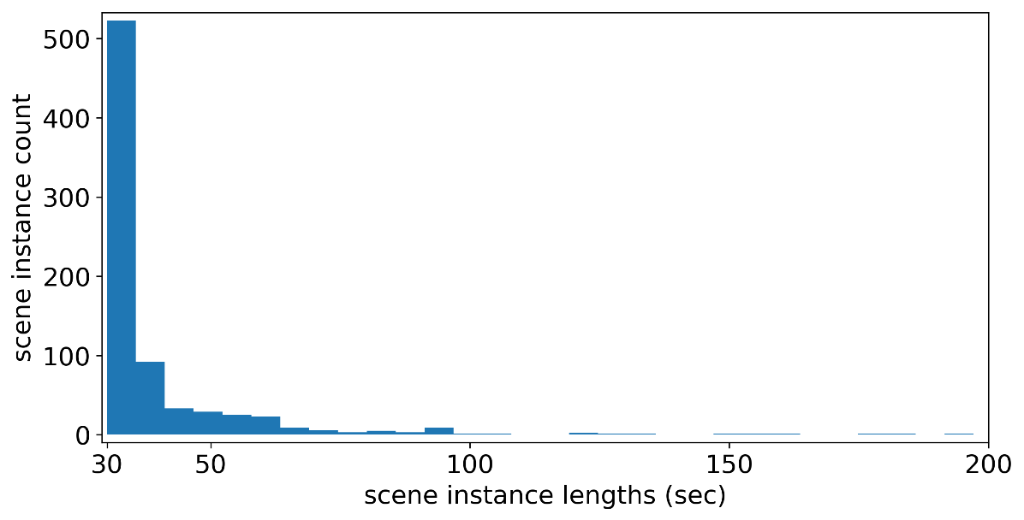
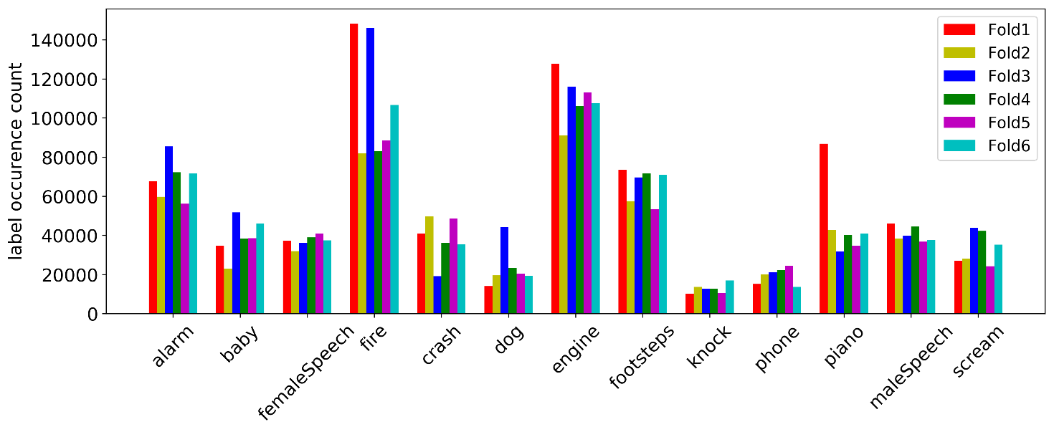
Data: Heterogenities
Scene instance distribution highly skewed
long sounds, e.g., fire/piano
short sounds, e.g., knock, (fe)maleSpeech
min. mixture length 30 sec
=> choice of input history length
Label distribution variations
across folds
across classes (1-vs-all)
=> balanced training

Slide 8
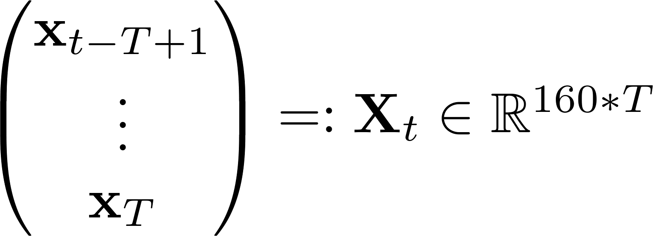
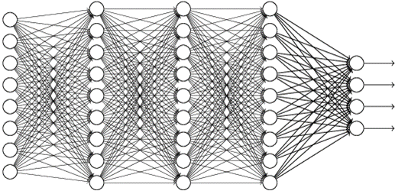

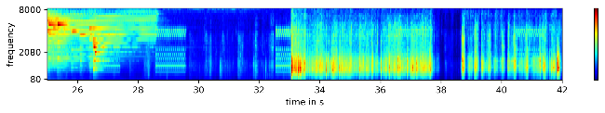
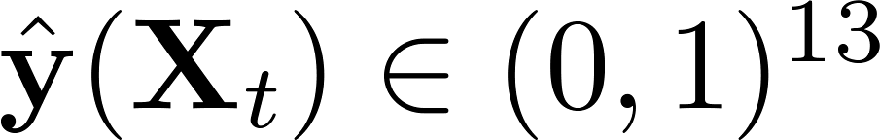
Model 1: Multilayer Perceptron
ReLU
ReLU
ReLU
Sigmoid
(not softmax)
Input history length
p(alarm)
p(baby)
… (13 classes)
p(scream)
Uniform weights Initialization, biases 0
Glorot & Bengio 2010
Dropout regularization (see later slide)
Hinton et al 2012
Srivastava et al 2015
Architectural hyperparameters
Input history length T (500ms, 5000ms, longer?) #layers (3, 4, 5, 6)
#neurons_per_layer (50, 100, 200, 400)
#dropout_rate (25%, 50%, 75%, 90%; same or increasing with depth)
data_stride (fix: stride 167ms = 500ms/3, subsampling resolution independent of T)

Slide 9
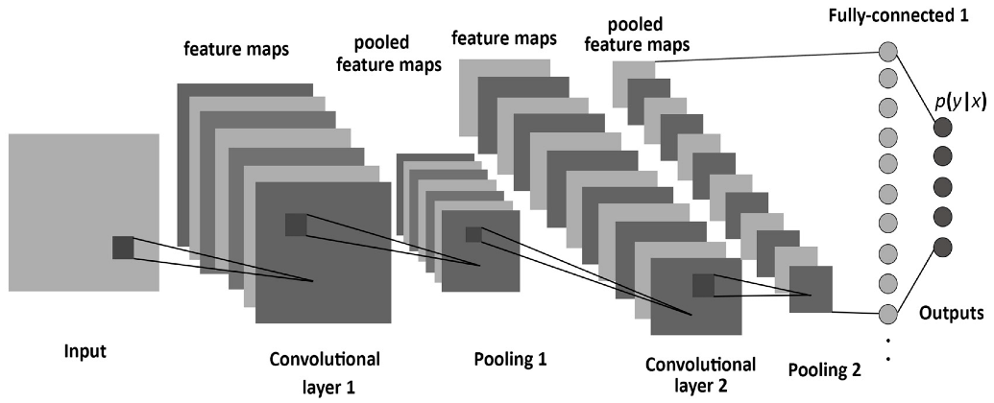
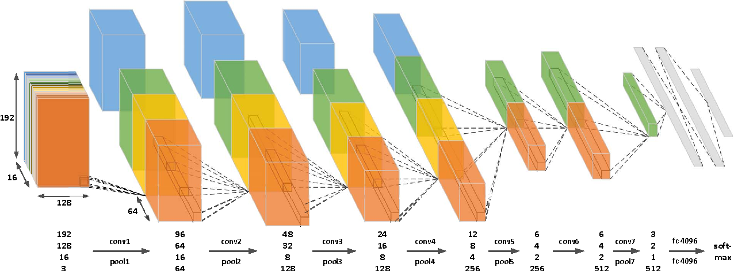
Model 2: Convolutional neural net
p(alarm)
p(baby)
… (13 classes)
Merge 2d/3d branches: common FC and output layers
p(scream)
Architectural hyperparameters
Input history length T (500ms, 5000ms, longer?)
#convolutional_layers (fix: 3)
#featuremaps_per_convlayer (increasing with depth)
#convolution_winsizes (fix: 3x3 / 3x3x3 with stride 1)
#pooling_winsizes (fix to 2 with stride 2)
#fullyconnected_layers (2, 3, 4, 5)
#neurons_per_fc_layer (fix: 100)
#dropout_rate (increasing with depth)
data_stride (fix: stride 167ms = 500ms/3, subsampling resolution independent of T)
Methodological choices
Max-pooling
ReLU transfer
Sigmoidal output
Batch normalization
Dropout regularization

Slide 10



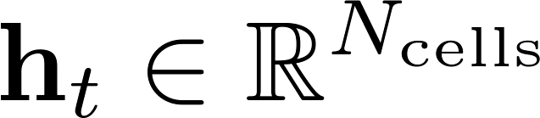
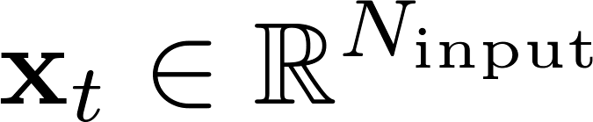



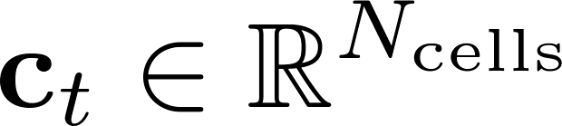
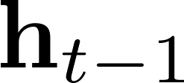
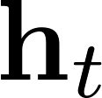
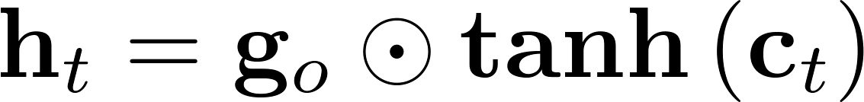
Model 3: Long short-term memory
Simple RNN cannot learn long-term relationships (vanishing gradient)
Solution: LSTM (here: no peepholes) or Gated Recurrent Units (GRU)
Transformation per time step
Vanilla LSTM:
cell state
cell state candidate
Learning:
Backpropagation through time
Forward pass: O(T)
Backward pass: O(T)
T: backpropagation length
forget gate
input gate
=> effectively: very deep feedforward network (T layers)
output gate
layer output (=recurrent input for next time step)

Slide 11
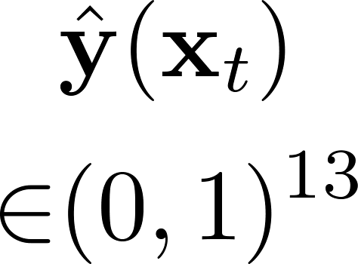
Model 3: Long short-term memory
p(alarm)
Fully Conn.
p(baby)
LSTM
LSTM
…
p(scream)
tanh
tanh
ReLU
Initialization
Random weights
Feedforward (FC & input-to-hidden LSTM): uniform
Recurrent (hidden-to-hidden LSTM): orthogonal
Biases 0 (except forget gate: bias 1)
Glorot & Bengio 2010
Saxe et al 2013
Gers et al 1999
Statefulness
cell state and output: saved and resumed between consecutive batches
Architectural hyperparameters
#LSTM_layers (2, 3, 4)
#FC_layers (fix: 2)
#neurons_per_LSTM_layer (50, 100, 200, 400)
#neurons_per_FC_layer (50, 100, 200, 400)
#dropout_rate_LSTM (25%, 50%, 75%, 90%; same or increasing with depth)
#dropout_rate_FC (25%, 50%, 75%, 90%; same or increasing with depth)
Input time history T for truncated backpropagation

Slide 12
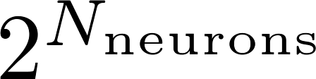
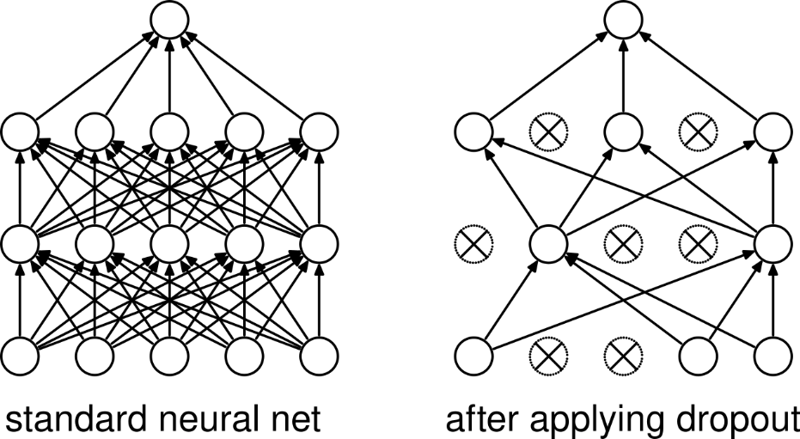
Dropout regularization
Effective regularization by randomly dropping neurons
Trained model corresponds to averaging the ensemble ( large)
Hinton et al 2012
MLP/Convnet: dropout directly applicable
Srivastava et al 2015
LSTM: more challenging because of temporally dependent states

Slide 13
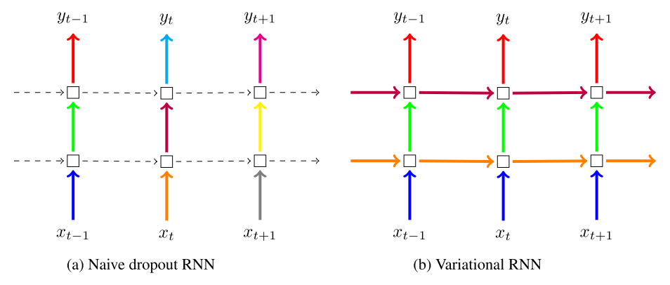
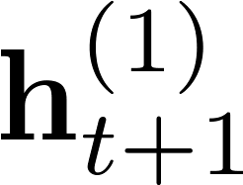
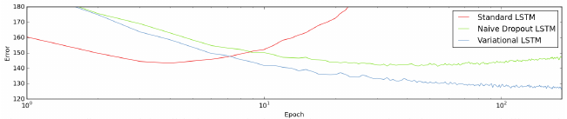
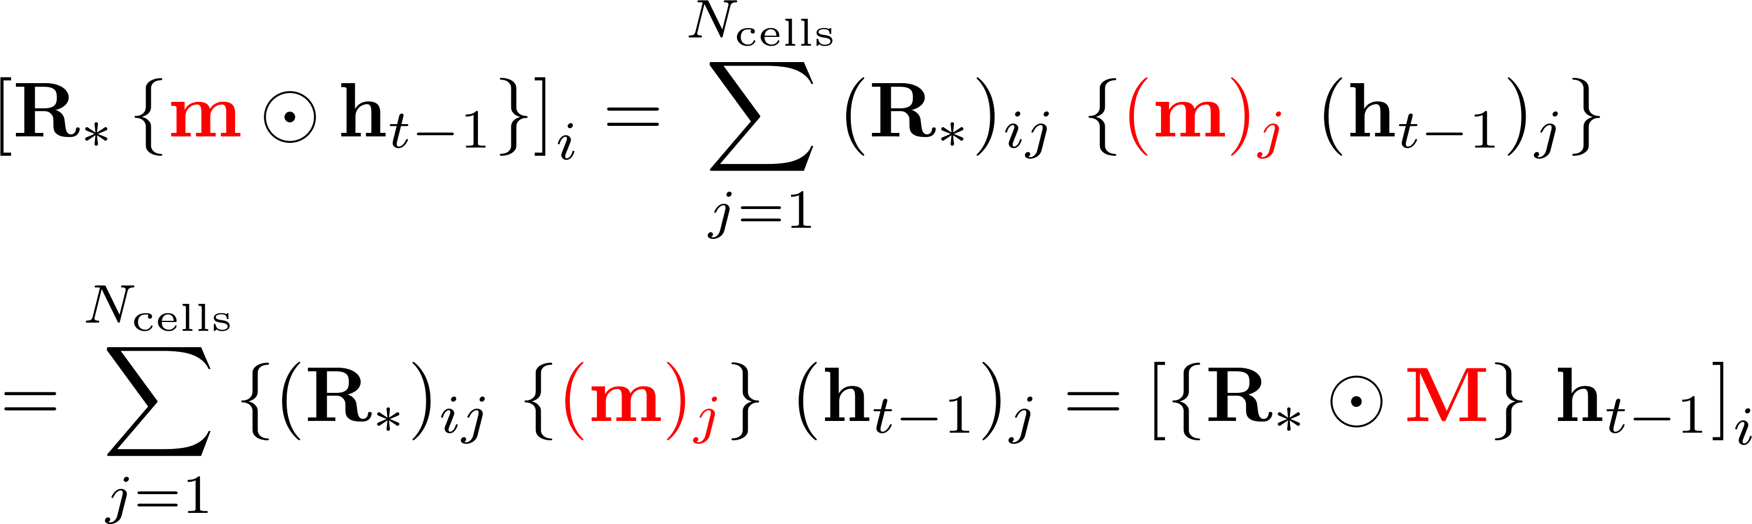
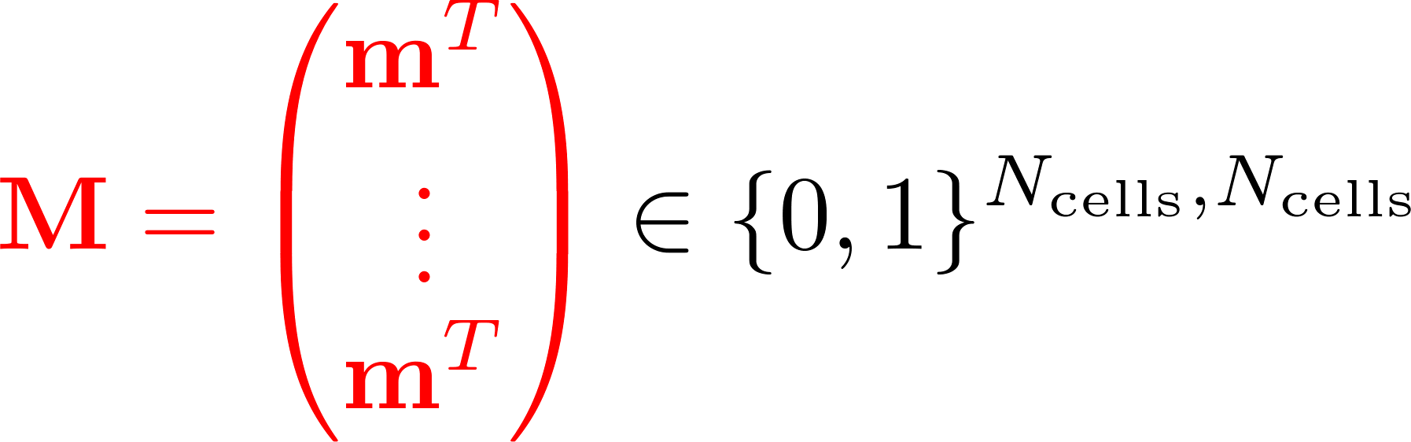

Recurrent Dropout
Recently: recurrent dropout technique developed
Interpretation: variational inference for posterior weight distribution
Implemented in deep learning frameworks but not in CuDNN
Gal & Ghahramani 2015
proof
Validation error in language modeling Task (Penn Treebank)
New: LSTM with variational
Dropout (cuDNN compatible)
LSTM with variational Dropout
cell state
cell state candidate
forget gate
input gate
output gate
output/recurrent input
Binary dropout mask for recurrent input, sampled once per forward/backward pass [per mini-batch]
Remark: input dropout as for feedforward networks (also sampled once per pass)

Slide 14

Neural network optimization
averaged over the 13 classes
Optimization objective: balanced accuracy (not differentiable)
Cost function: cross entropy averaged over classes
class weights to balance the uneven training distribution
Adam: modern mini-batch stochastic gradient descent
Adaptive learning rate per parameter
Adaptive momentum per parameter
Early stopping (free lunch) regularization
Stop when validation performance (avg. across the last few epochs) decreases
Learning rate and batch size: hyperparams that don‘t affect cost function
Values first chosen s.t. training is most efficient
Fine tune them after cross validation based hyperparameter optimization
Kingma & Ba 2015

Slide 15
Hyperparameter Optimization
Bergstra & Bengio 2012
Approach: randomly sample hyperparameters
Evaluation hyperparams. w.r.t. partial cross validation performance
Performance measure: balanced accuracy
First level: single 5-1 train-validation split => discard trash
Second level: two fixed (of 6) 5-1 splits => keep best 30% models
Third level: three (of 6) 5-1 splits => take best hyperparam. comb.
Fourth level: fine-tuning of learning rate, batch size, regularization strength
Final model: trained on all 6 folds, evaluated on test data
averaged over the 13 classes
Training & validation data
Test data
1/8 of each class’ sounds
mixed together in 80 scenes
(random nSrc, SNR, azimuth)
1/8 of sounds for each class
mixed together in 126 scenes (systematically parametrized)
Multiconditional training as demonstrated: Trowitzsch, Mohr, Kashef, Obermayer 2017, IEEE Audio Speech Language Process.

Slide 16
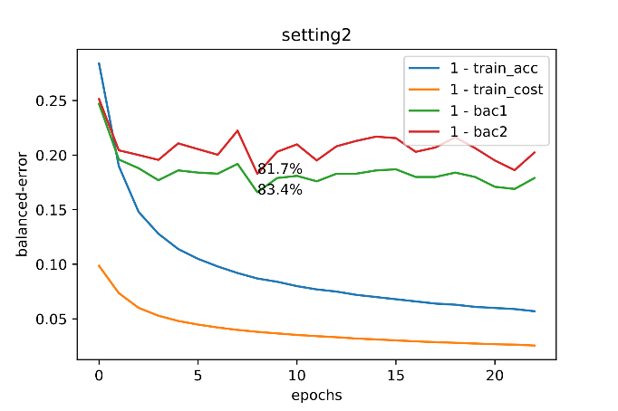
Preliminary Results
Trowitzsch, Mohr, Kashef, Obermayer 2017,
IEEE Audio Speech Language Process.
For comparison: block-interprete labels
Class i active in last 500ms (with 75% coverage)? Then y_{i}=1 else 0
Baseline model: logistic regression with L1 regularization
One feature vector for each block of size 500ms (2/3 overlap)
Features: statistical moments of ratemap/AMS and temporal derivatives thereof
Subsampling of data due to memory requirements of glmnet (here: harmless)
Cross validation Performance: 79.5 % nSrc-weighted balanced accuracy v2
Validation performance of fold 1: 78.7% nSrc-weighted BAC₂ (>= BAC₂ [probably])
Current state (beginning of hyperparameter search):
LSTM: 82.3 % balanced accuracy of full CV (fold 1: 83.4% BAC, 81.7 % BAC₂) fold 6 (only slightly better, yet to be improved
Fold 1 (1: validation, 2-6: training)
averaged over the 13 classes
=1-BAC
Best model so-far (setting2)
Backprop length T = 25sec (2500 frames)
Batch size = 40
LSTM layers: 3
LSTM cells per layer: 581
FC layers: 2
Neurons per FC layer: 192
Dropout rate: 10%
Learning rate: default (0.001)

Slide 17
Challenges
Limited resources
Despite: math cluster‘s GPUs & NVIDIA‘s donations mediated through Youssef
Consequence: hyperparameter space will be sampled rather coarsely
Implementation complexity: specificities of data set and framework
One pipeline is already running, the second one almost
Changes in design / methodology on the fly
Hopefully we have reached a stable configuration

Slide 18
Outlook
Results for ConvNet and MLP model variants
Investigate effect of input history length T (and check input subsampling factor)
More hyperparameter combinations for LSTM (level 1)
(Partial) cross validation results (levels 2+3)
Fine-tuning (level 4)
Test set evaluation: effect of scene parameters (SNR, azimuth)
Instant labels (=original labels; neural network models applicable)
Change from Adam to problem-specific optimization:
Superconvergence (by large learning rates)
Learning to learn gradient descent by gradient descent
Smith & Topin 2017
Andrychowicz et al 2016

Slide 19
Contributions
Heiner (NI project): data pipeline, LSTM, visualizations
Changbin (Master Thesis): LSTM, preliminary results
Alessandro (Bachelor Thesis): ConvNet
Ivo: Dataset design, baseline (glmnet) model, supervision
Moritz: MLP, ConvNet, supervision

